Slide 1
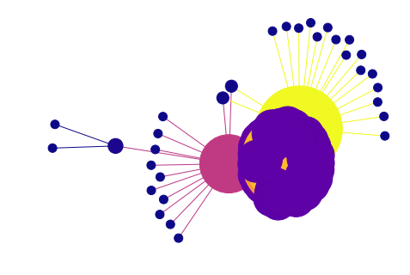
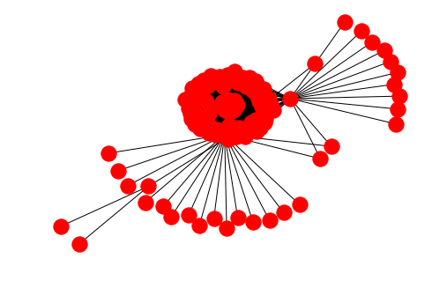
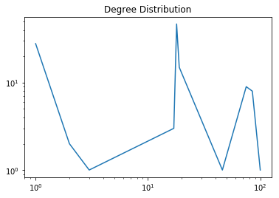
Habib University Website Graph.
Introduction:
Collection of Data:
The Graph focuses on the urls/links of the Habib University Website that shows the connection b/w them .
We used HABIB university website for the collection of data.
Number of Nodes | Number of Edges | Average Degree
1511111 This signifies that we took a hundred and fifteen link into consideration (so far). | 651 This signifies that the connection between those 115 nodes are 1359 times. | 23.64 At average a link is connected with 23.64 more links .
Group Members:
SHAHZAIB AWAN
HASEEB MALIK
ZAHEER KHATRI
MOHSI N SHIKARI
(18b-134-se)
(18b-120-se)
(18b-001-se)
(18b-005-se)

